Slide 1

ZenLock Because Your Attention is Your Most Valuable Asset
HSnP Solutions
Professor Jay Martin
IE 466
8 December 2025

Slide 2
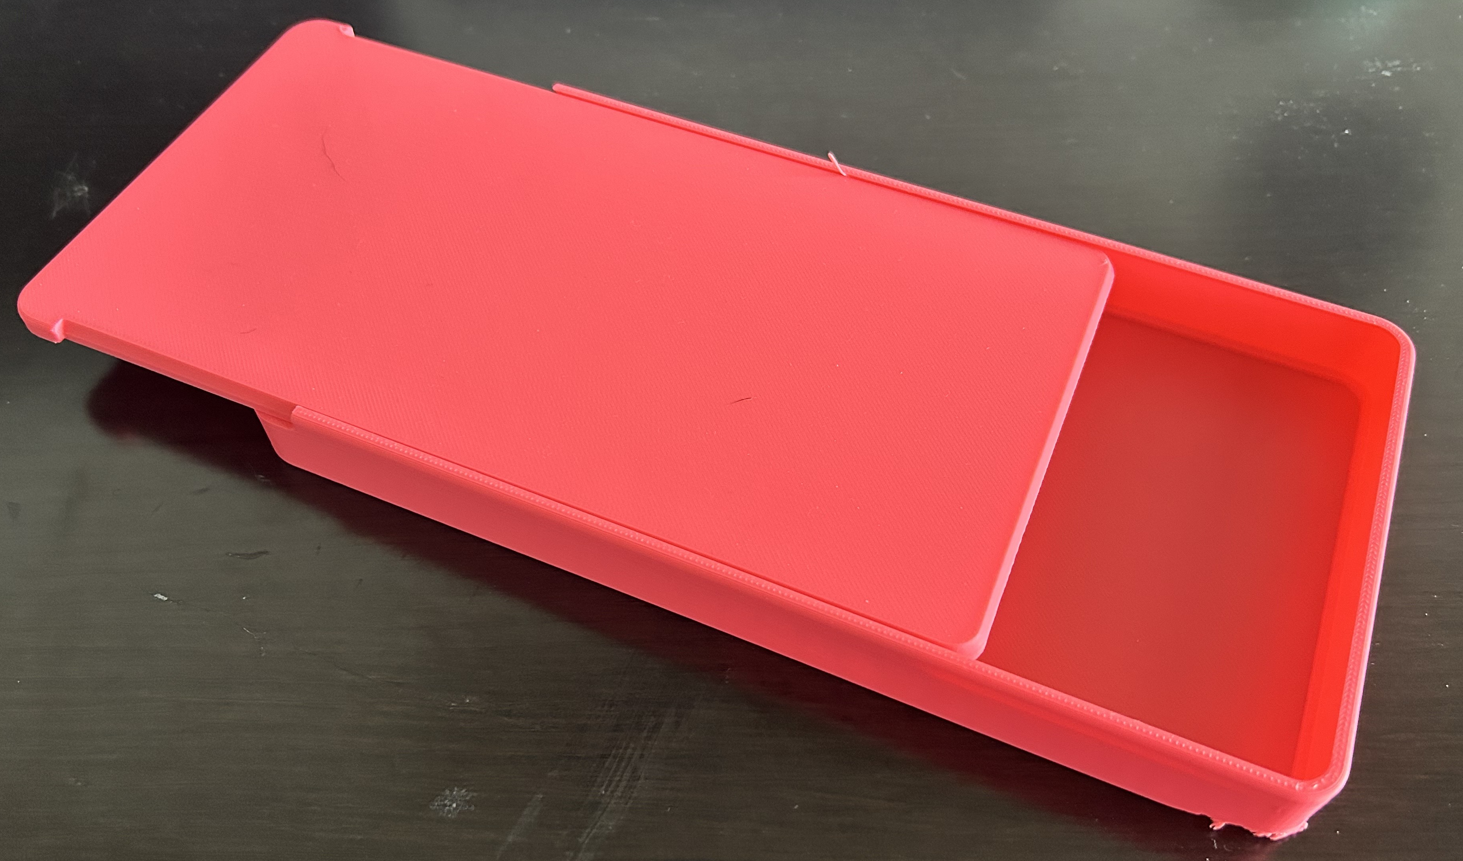
ZenLock by HSnP Solutions
Problem: Phone addiction and driver safety
Costs/Profitability: Cost to produce: $3.45 Market Price: $20-$25 Profit: $16.55-$21.55 | Market Research: Pros: Useful to decrease phone use while not being too intrusive Can see use case for increased driver safety Cons: Design too generic and tough to figure out

Slide 3

Final Product - Key Features
Automatic lock
For when the vehicle is in motion
Tamper-resistant enclosure
To prevent phone access while driving
Hands-free compatibility
Ensure that bluetooth, audio navigation still usable
Universal phone fit
Ideal for most smartphones
Easy and quick docking
With one-hand insertion/removal
Emergency override
For 911 or crash situations
Secure vehicle mounting
Dashboard/vent mount options
Heat- and impact-resistant materials
For in-car durability

Slide 4

Prototype + Validation
Successful print of 2/3 pieces
Locking mechanism failed to print and was discarded after multiple attempts
PLA flimsy but production ABS would be much more durable, and the design allows for injection molding
Lid slides effortlessly

Slide 5
Market Opportunity
Estimated Sale Price:
$20-$25
(Based on comparable products and competitor pricing)
Who is the Customer?
- Students (primary users)
- Young professionals
- Wellness/self-care focused individuals
What Customers Think They Want:
- A simple way to lock away their phone
- A distraction-free study or focus tool
- Something simple, portable, and easy to use
Why Our Product Fits:
- Creates intentional "no-phone" periods
- Simple and reliable locking mechanism
- Durable, lightweight, universal design
- Supports good habits and productivity
What They Actually Need:
- A physical barrier that prevents impulsive phone use
- A reliable, tamper-resistant lock
- A routine supporting tool

Slide 6

BOM/Cost Structure
Bill of Materials (ABS – Impact-Resistant Plastic)
- Body(ABS): $2.50-$3.00
- Lid(ABS): $1.25-$1.75
- Insert Tray(ABS): $1.00-$1.25
- Lock(ABS): $0.50-$0.75
Prototype Manufacturing Cost (3D Printed PLA)
- Printer: Prusa MK3.5 & MK3.5S .4 Nozzle
- Print Time: 4.5 hours (Box + Lid + Insert + Lock)
- Estimated Prototype Cost: $8-$9 per unit
Mass Production Cost (Injection-Molded ABS)
Industry-based estimates
- Estimated Total-Mass Production Cost: $3-$4.15 per unit
- ABS pellets: $1.50-$2.00 per lb
- Injection-molding cost: $0.80-$1.20 per unit
- Assembly + packaging: $0.50 per unit
- Transportation & Bulk Shipping Costs: $0.20-$0.40 per unit (shipping/distribution)

Slide 7
Closing
We identified a real problem: constant distraction and impulsive phone use.
ZenLock delivers a physical, reliable barrier that creates intentional focus.
Affordable and competitive: estimated retail price $20–$25.
Low-cost, scalable production: mass-production cost $3–$4.15/unit.
Strong market fit: students, professionals, wellness-oriented users.
Simple design, durable materials, universal compatibility.
ZenLock helps people reclaim attention, build routines, and stay productive.

